Slide 1
MOVIE RECOMMENDATION SYSTEM
Submitted By -
Omkar arade

Slide 2
Introduction
Movie recommender systems
A movie recommendation system, or a movie recommender system, is an ML-based approach to filtering or predicting the users' film preferences based on their past choices and behavior.
Movie recommender system has the ability to predict whether a particular user would prefer an item or not based on the user's profile.
This movie recommender system is constant base recommender where we create a tags and try to find out similar types of movies.

Slide 3
Overview
First we will start with the data where we have two dataset
1. Movies
2. credit
We meagre two dataset and create one view. The data is spread across 4809 rows and 23 columns.
Then we Dropping the column which is not usable for this model.
After that we Pre-Processing data because we have some problem in dataset
I concatenate overview, genres, keywords, cast and crew variable to create Tags
And to find similar type of movie on the basis of tags, we create a text vectorization

Slide 4
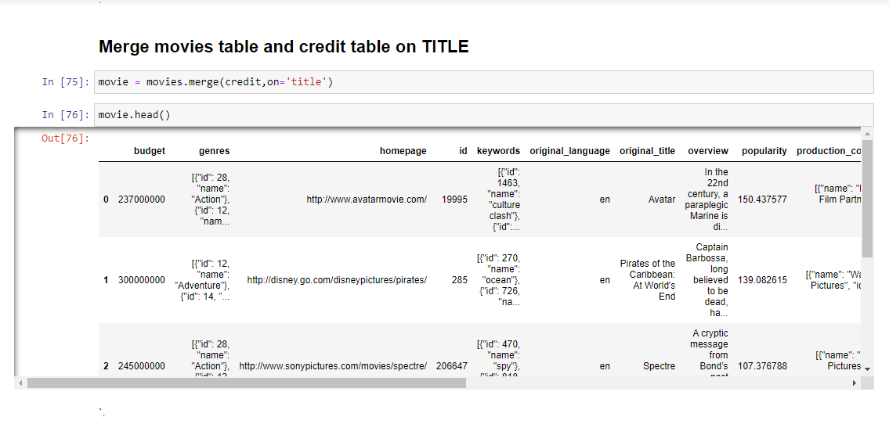
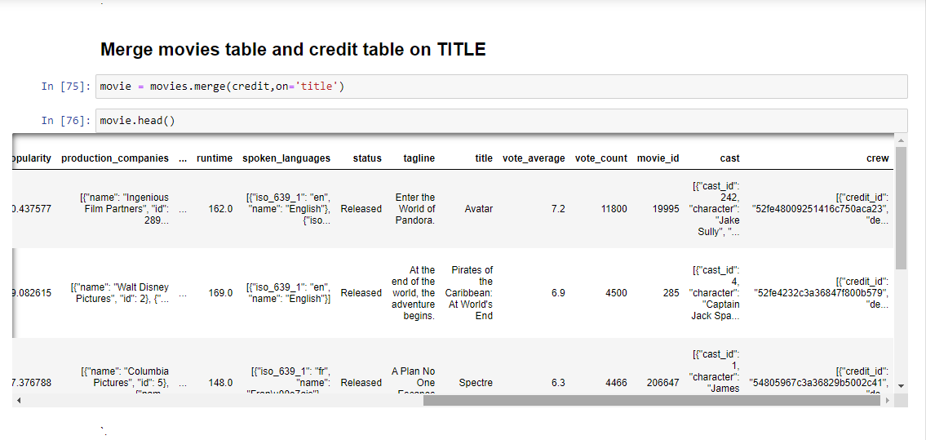
The Dataset
The data is spread across 4809 rows and 23 columns.
There are both numerical and categorical data.

Slide 5
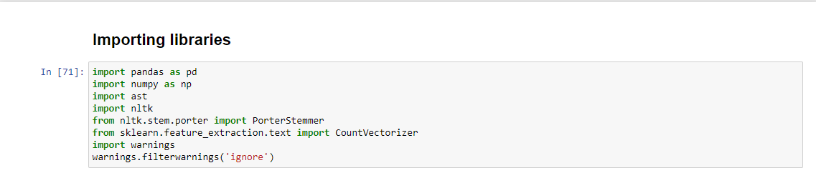
Python Libraries

Slide 6
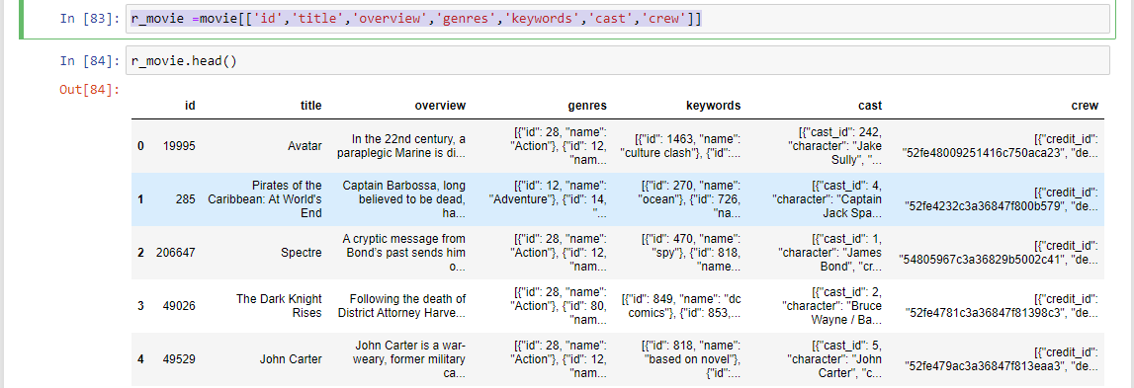
Then we Dropping the column which is not usable for this model.
We drop the columns which is not usable to recommendation the movie and create new dataset. After dropping columns we have 4809 rows and 7 columns.
Syntax : r_movie =movie[['id','title','overview','genres','keywords','cast','crew’]]

Slide 7
Data Pre-Processing
Handled the missing values.
Fetch name form 'genres' and 'keywords’ columns.
Fetch top 3 actor name form ‘cast’ column and director name from ‘crew’ column.
Change the type of variable.
Concatenate overview, genres, keywords, cast and crew variable to create Tags column.
Create a text vectorization.

Slide 8
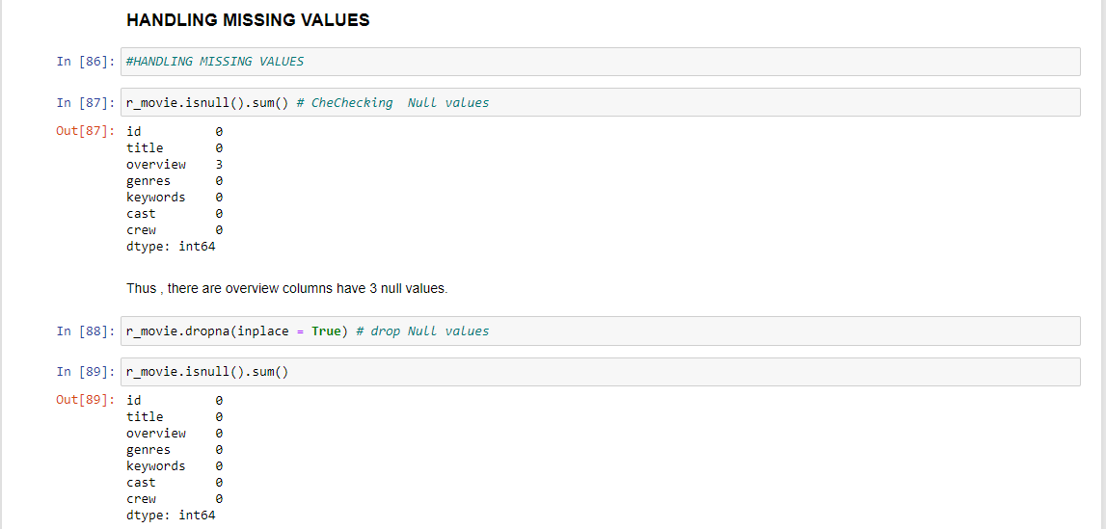
Handled the missing values.
In this dataset we have three missing values in overview column.
If we drop this three values we don’t have impact on our model so we can drop it
Syntax: r_movie.dropna(inplace = True)

Slide 9
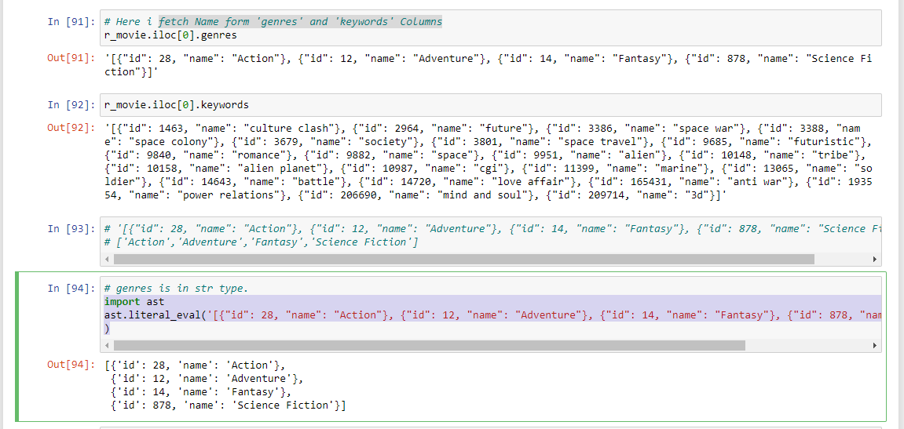
Fetch name form 'genres' and 'keywords’ columns.
In ‘genres’ column and ‘keyword’ column we have list of dictionary.
In dictionary we have keys is ID and there value is Name. We extract the name from dictionary and name contain type of movie
To do that first convert these list of dictionary into string
than we can create helper function
Syntax : import ast
ast.literal_eval('[{"id": 28, "name": "Action"}, {"id": 12, "name": "Adventure"}, {"id": 14, "name": "Fantasy"}, {"id": 878, "name": "Science Fiction"}]'
)

Slide 10
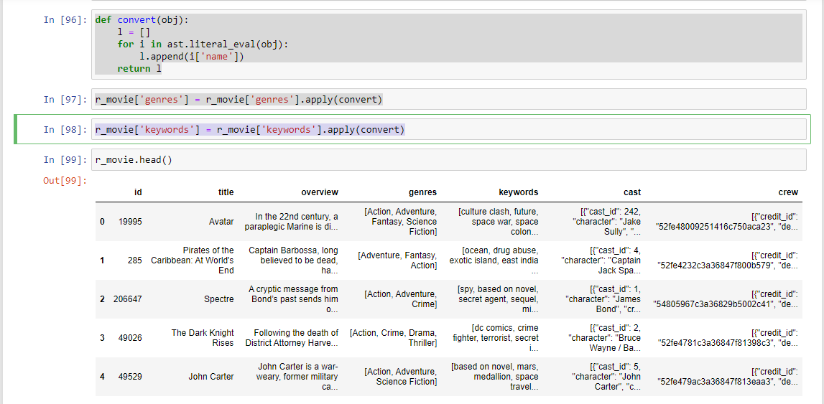
Then we create helper function and apply on genres column and keyword column helper function syntax : def convert(obj): l = [] for i in ast.literal_eval(obj): l.append(i['name']) return l r_movie['genres'] = r_movie['genres'].apply(convert) r_movie['keywords'] = r_movie['keywords'].apply(convert)

Slide 11
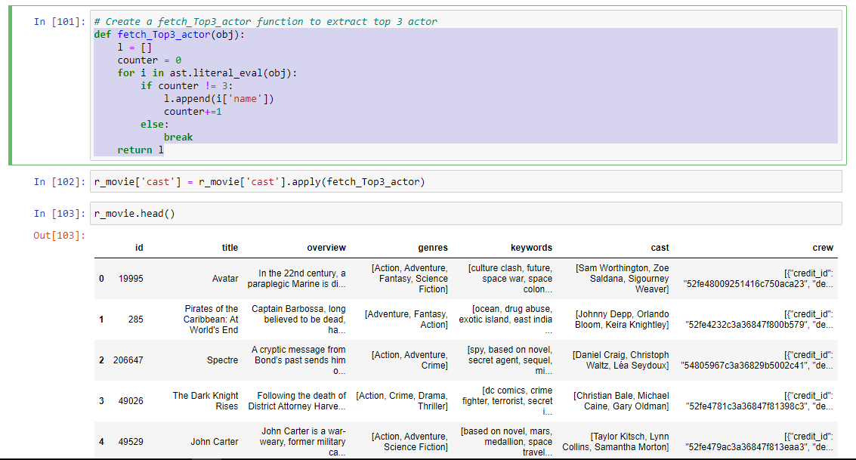
Fetch top 3 actor name form ‘cast’ column and director name from ‘crew’ column.
In ‘cast’ column and ‘crew’ column we have list of dictionary.
In dictionary we have keys and there values . We extract the top 3 Actor name and Director name from dictionary.
To do that I create helper function
Syntax :
def fetch_Top3_actor(obj):
l = []
counter = 0
for i in ast.literal_eval(obj):
if counter != 3:
l.append(i['name'])
counter+=1
else:
break
return l

Slide 12
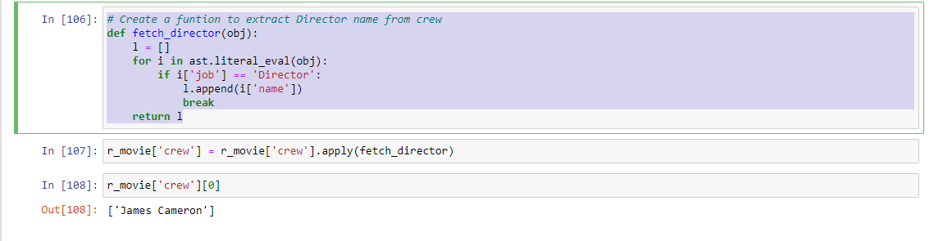
Create a funtion to extract Director name from crew Syntax: def fetch_director(obj): l = [] for i in ast.literal_eval(obj): if i['job'] == 'Director': l.append(i['name']) break return l

Slide 13
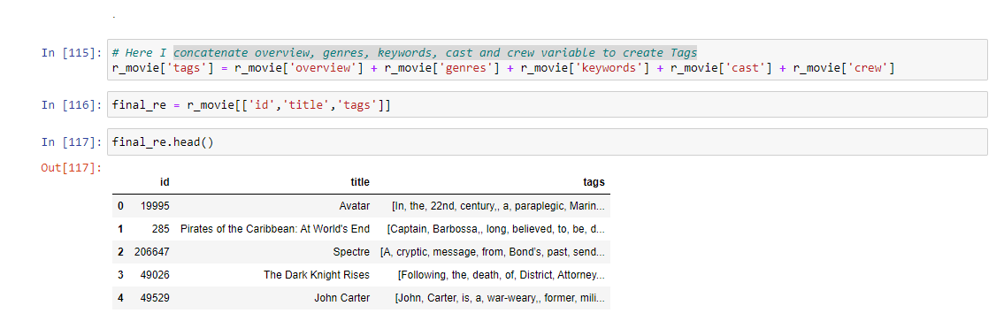
Concatenate overview, genres, keywords, cast and crew variable to create Tags column.

Slide 14
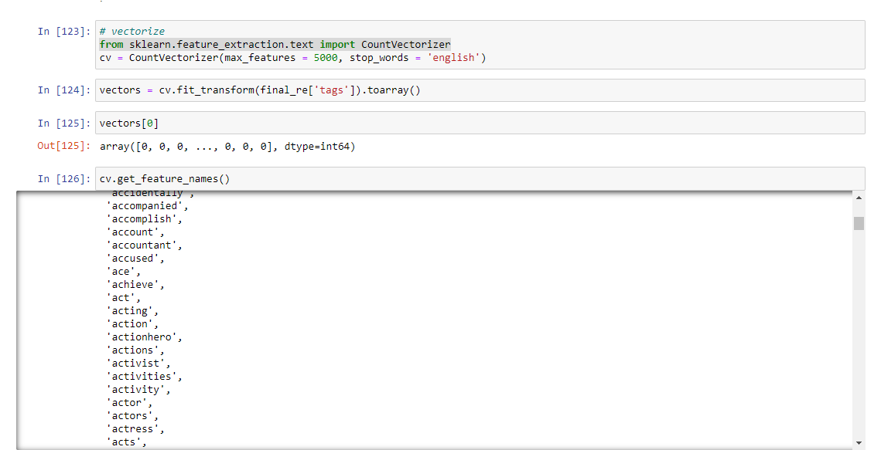
And to find similar type of movie on the basis of tags, we create a text vectorization
First we concatenate all the tags and we get large text. Than we extract top 5000 words who's frequency is most. Now we compare this 5000 words with tags.

Slide 15
Conclusion
Several regression models are built to predict the price of houses on given house features.
To improve the model, hyperparameter tuning of some selected models is done using both RandomizedSearchCV and GridSearchCV.
The models evaluated has provided the satisfactory results.
As a recommendation, this model (or a version of it trained with more recent data) can be used as a part of decision making to buy a house in the area covered by the dataset to have an idea about the actual price.

Slide 16
Thank You!

